Slide 1
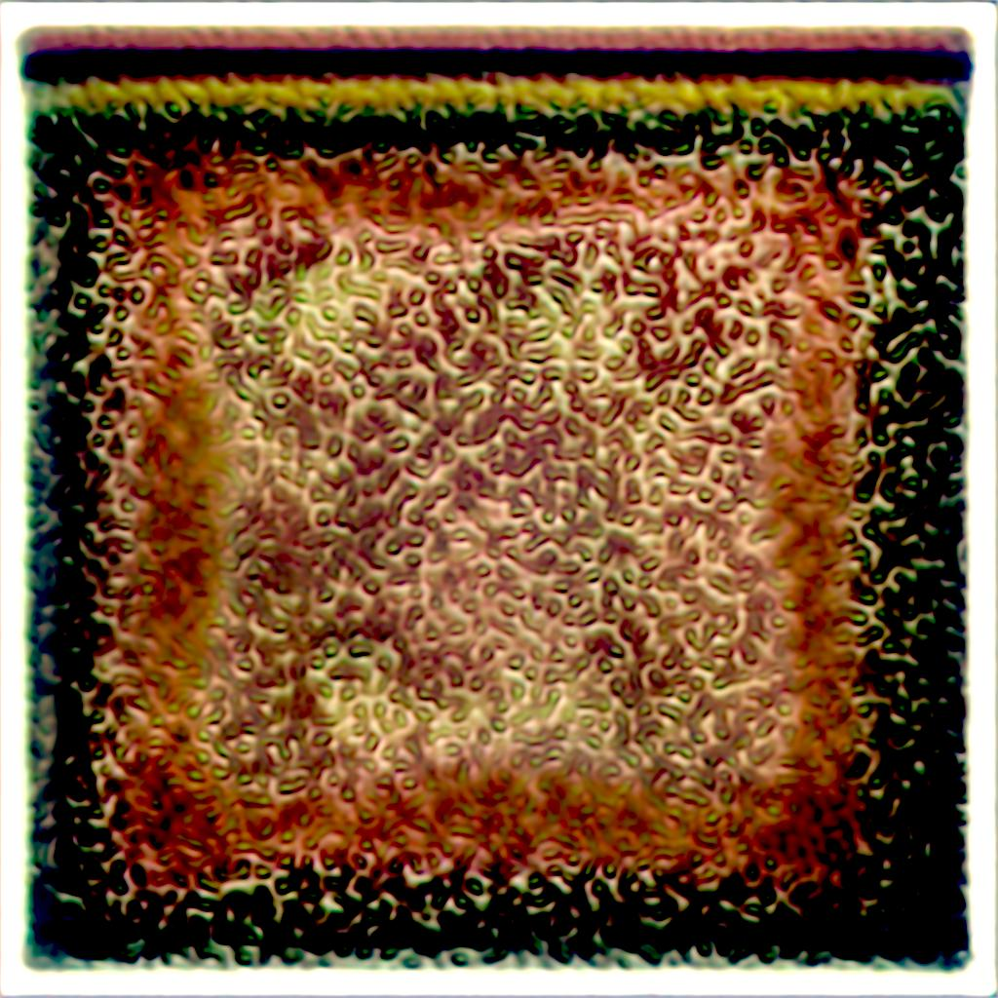
Generative adversarial networks for agricultural image generation and generative super resolution
2022-05-17
Olli Niemitalo (Olli.Niemitalo@hamk.fi), Roman Tsypin
HAMK Smart Research Unit, Häme University of Applied Sciences, Finland

Slide 2
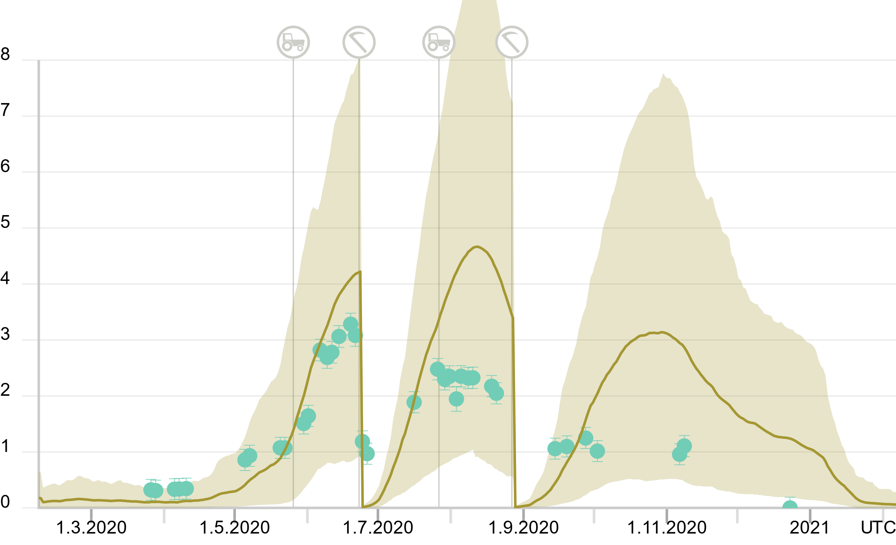
Vegetation remote sensing
Needed for example in crop modeling in carbon sequestration research, see fieldobservatory.org
Especially important when scaling up to thousands of farms
Modeling output
Observation derived from satellite image
Leaf area index (LAI) (m² / m²)
Satellite image-derived LAI and STICS model hindcast from Qvidja farm with 90 % confidence intervals. Source: https://www.fieldobservatory.org/en/online-field-data/?site=qvidja

Slide 3
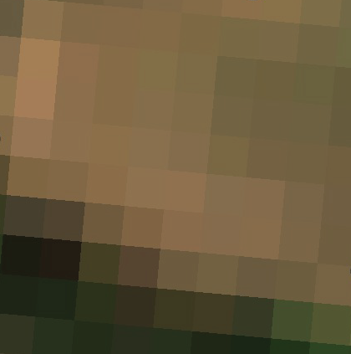
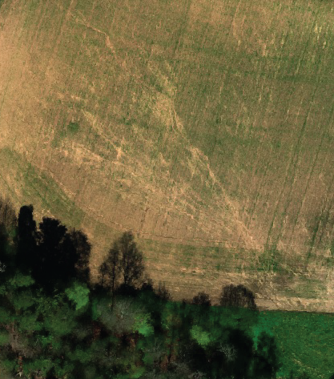
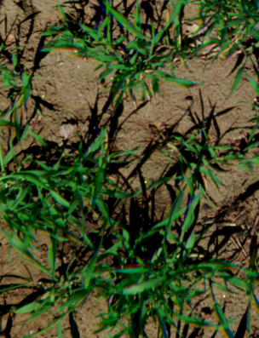
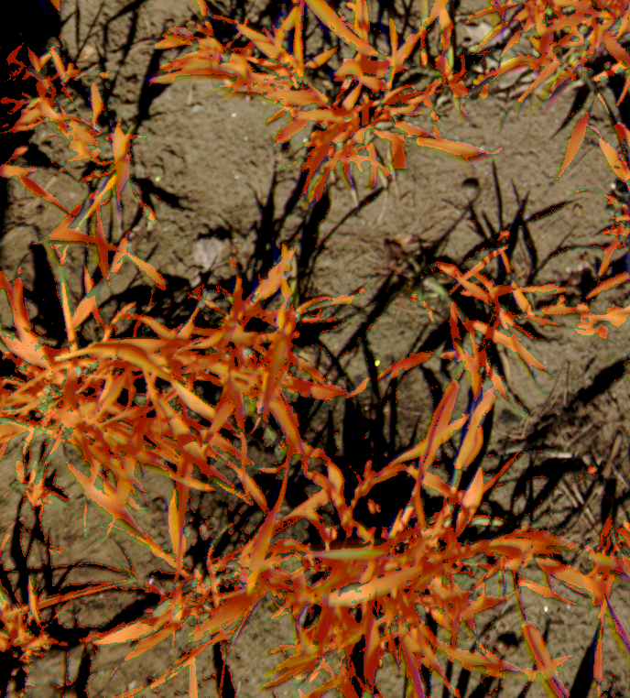
Sentinel 2 satellite image
Drone image
Close-up image
Vegetation analysis
Image: ESA
What if we could go from here…
…to/or here …
…then here,
analyze,
and infer our results back?

Slide 4
Sentinel 2 satellite image
Possible drone images
Possible close-up images
Possible vegetation analysis results
Need to work with distributions and statistics, and plenty of uncertainty.

Slide 5
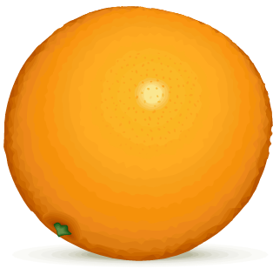
Generative model
Generates data points that follow an approximate distribution of real data
G
Fake data
approximates
Real data
Generative model

Slide 6
Conditional generative model
A conditional generative model randomly generates data points that follow an approximate conditional distribution of real data
Condition
G
Fake data
approximates
Real data

Slide 7
Conditional generative model
The condition can be a function of the data
Condition
Classify
fruit
G
Fake data
approximates
Real data

Slide 8
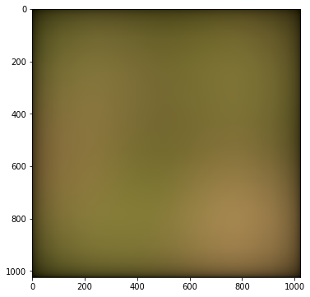
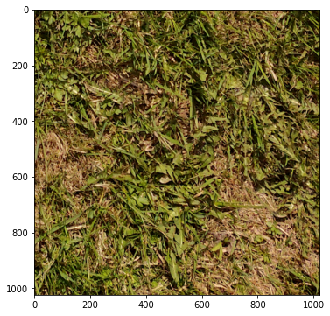
Generative super resolution
Fake data is conditioned on low-pass filtered (blurred) real data
Condition
Low-pass
filter
G
Fake data
approximates
Real data

Slide 9
Toy problem statement
Acquire training images of lawns with various degrees of vegetation cover
Train a generative model on the data
Given a low-resolution image of the lawn as conditioning input, the model shall sample from the approximate distribution of what the lawn might look like at high resolution
The model shall be able to handle arbitrarily large images
Ideally…

Slide 10
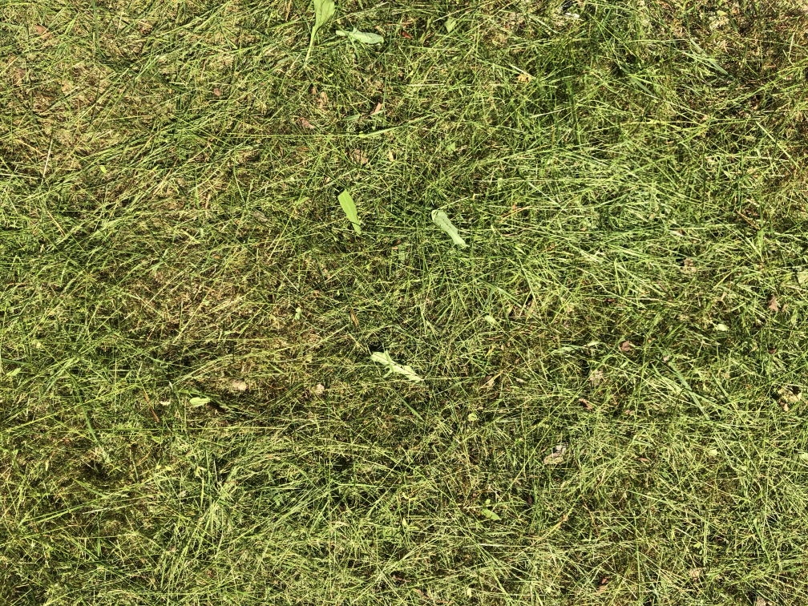
Toy training dataset

Slide 11
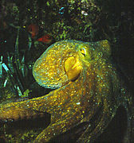
Least square generative adversarial network
A machine learning method, a variant of GAN
arXiv:1406.2661 [stat.ML], arXiv:1611.04076 [cs.CV]
Generator (G) and discriminator (D) networks compete to minimize their respective losses
Real data
D
MSE(x, 1)
+
Discriminator loss
Noise
G
Fake data
D
MSE(x, -1)
MSE(x, 1)
Generator loss

Slide 12
Our super-resolution GAN training setup
low-pass
filter
Real data
D
MSE(x, 1)
Discriminator loss
Noise
G
Fake data
D
MSE(x, -1)
-
+
Direct loss
low-pass
filter
MSE(x, 1)
MSE
+
Generator loss
Also: additive noise, rotation and exposure augmentation of discriminator input, gradient accumulation, stochastic gradient descent with random training image selection and random cropping

Slide 13
Our model design
Generator and discriminator are convolutional neural networks – locality!
Batch normalization, no pooling layers
Spatial data kept 2x oversampled throughout the network using isotropic anti-aliasing layers – translation invariance!
Generator
Encoder-decoder with skip connections (8 level U-net)
Noise input: 1024x1024x1, conditioning input: 1024x1024x3
Output: 1024x1024x3
Can generate arbitrarily large images piecemeal from deterministic noise input
Discriminator
Encoder structure (first half of 7 level U-net)
Input: 1024x1024x3 center-cropped to 512x512x3
Output: 8x8x1
Output center-cropped to 2x2x1 for adversarial loss
Early training video on another toy dataset: https://youtu.be/Ecz4kHMEE7o

Slide 14
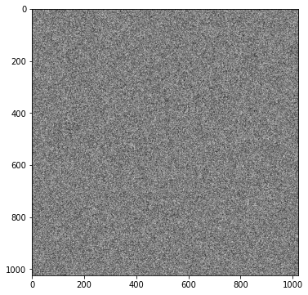
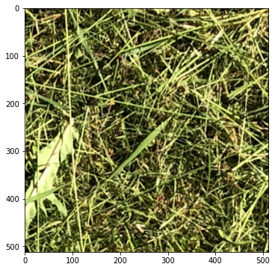
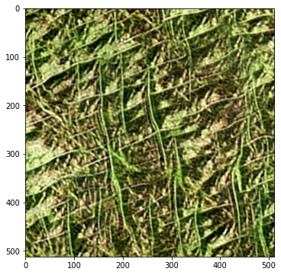
Toy problem preliminary results
Noise input
Real data
Fake data

Slide 15
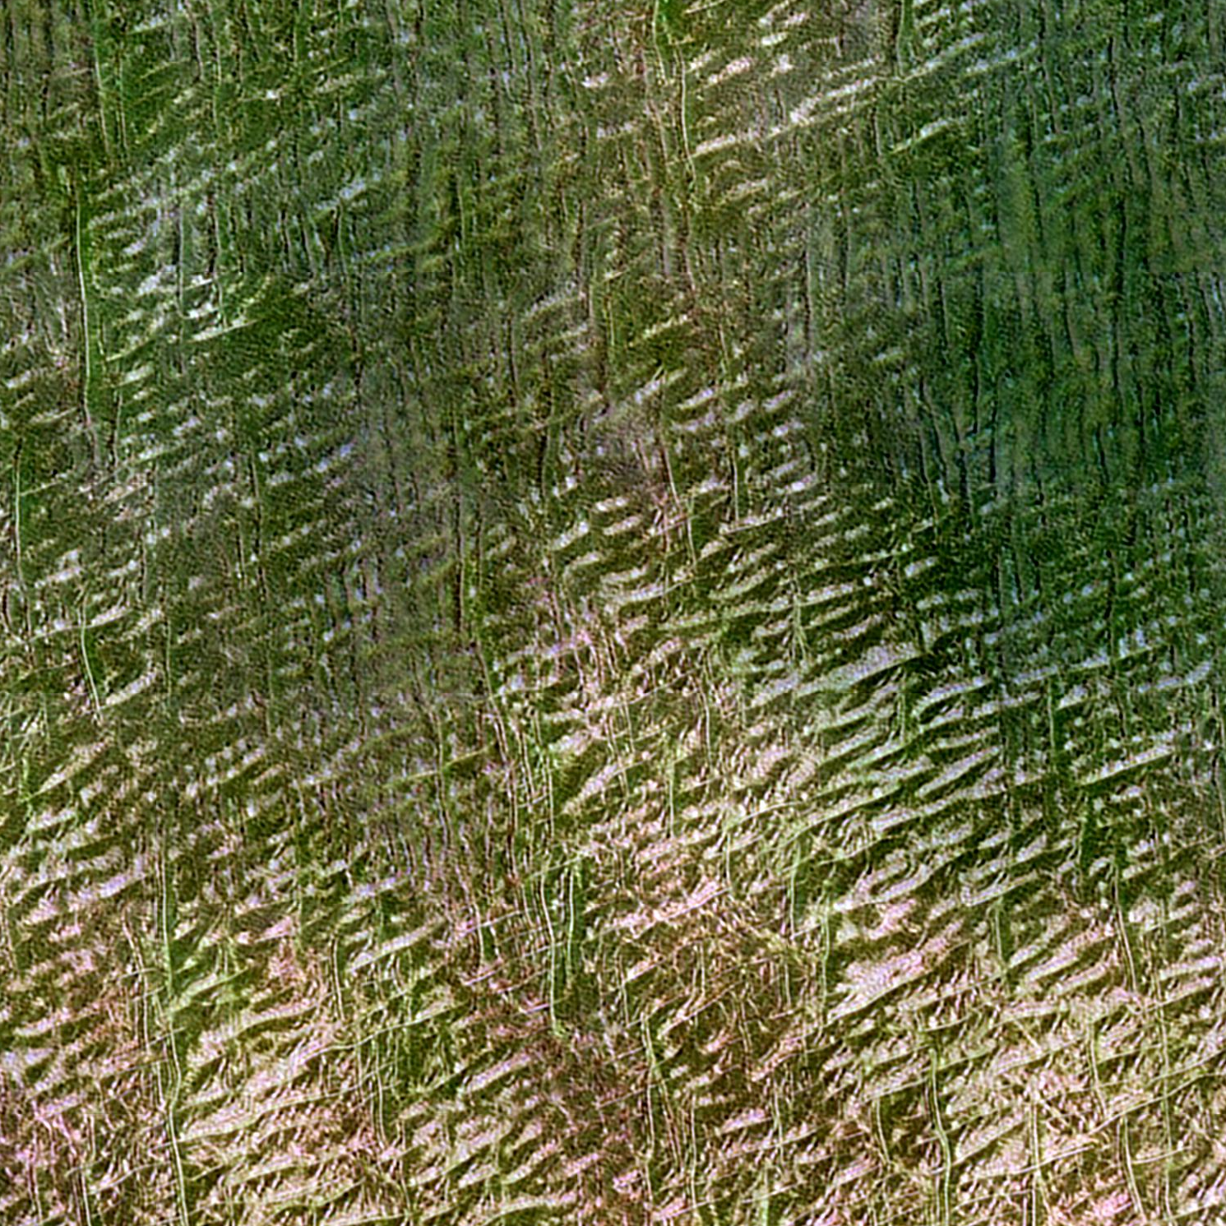
Toy problem preliminary results
Drone mosaic (conditioning input)
Generated image zoomed in
Generated image zoomed in more
Generated image
✔️”Vegetation” ✔️Nearly seamless 256x256 tiling
❌Realistic vegetation ❌Realistic soil

Slide 16
Discussion and future work
GAN improvements
Tune the model structure
Design more optimal anti-aliasing filters
Try calculating products of feature maps. Controlled bandwidth: c = a * b ➔ bandwidth(c) = bandwidth(a) + bandwidth(b)
Try other models than pure convolutional networks, say Vision Transformers
Steerable network?

Slide 17
Discussion and future work
Current super-resolution model drawback: Vegetation is assumed to be independent in two locations separated by tens of cm. Add a flat noise input!
A time series of training images would be more informative than a single image from each location
Generate 3-d models of vegetation
Train generative models for transforming images between different sensor types with incompatible channel spectral sensitivity curves

Slide 18
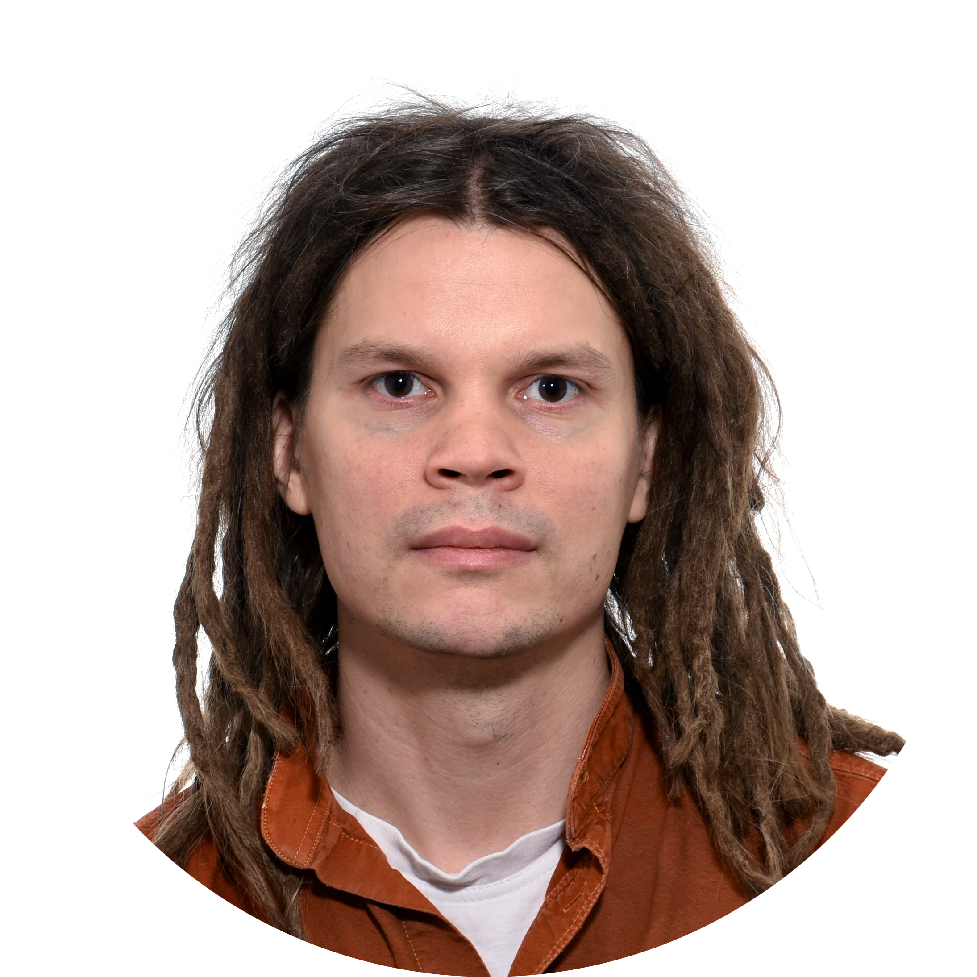
linkedin.com/school/hamk-häme-university-of-applied-sciences
blog.hamk.fi
facebook.com/hamkuas
twitter.com/hamk_uas
instagram.com/hamk_uas & instagram.com/hamkstories
Olli Niemitalo, data analyst
youtube.com/user/HAMKuas
Olli.Niemitalo@hamk.fi
hamk uas
pinterest.com/hamkuas

